Slide 1
Expeditor
Urban Food-Supply Marketplace and Delivery Optimization System
IFT 402 Paul Polsinelli

Slide 2
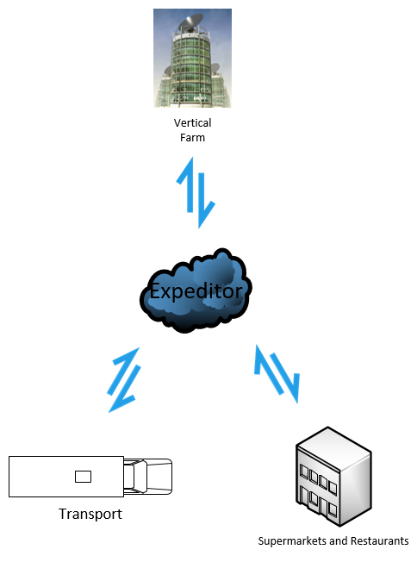
Fresh food, produced by indoor vertical farms, delivered to local markets with next to zero food waste, at minimal cost, with maximum fuel savings.
Expeditor

Slide 3

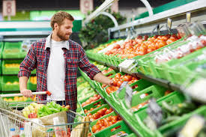
The Urban Stakeholders: Supermarkets, Restaurants, and their Customers

Slide 4
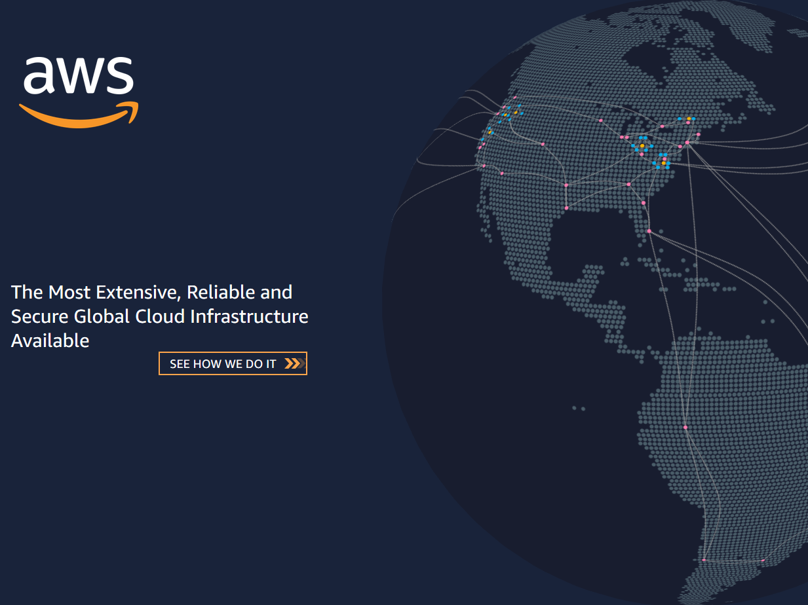









The Technology
Tensorflow
Keras
<html>
API REST framework
<CSS>
<javascript>

Slide 5
The Build
Build 3 has expanded the database to 10 vertical farms.
The excel distance matrix has a transport sheet added to it with its own distance matrix and slightly modified vb code. It has cells to determine and display which transport hubs are closest to each vertical farm.
The Expeditor script has been added to to include a capacity randomizer to simulate real world supply capacities, a process to iterate through and select the geographically closest vertical farm with capacity to the client, and the closest transport hub to that vertical farm to complete the order and supply chain process.
A simple SMTP order confirmation email code has also been added to the script with an attached gmail account specifically for Expeditor.
Django script has been updated to include the new tables.

Slide 6
Accomplishments
Predictive AI script enhanced with functionality to select and update closest vertical farm with capacity
Process to select closest transport hub to closest vertical farm with capacity added for maximum efficiency
A randomizer simulates capacity fluctuations in the vertical farms
Database tables added for a total of 10 vertical farms
Custom API’s added for additional vertical farm tables
Distance matrix sheet added for 3 transport hubs that calculates closest transport hubs to each vertical farm

Slide 7

Progress

Slide 8
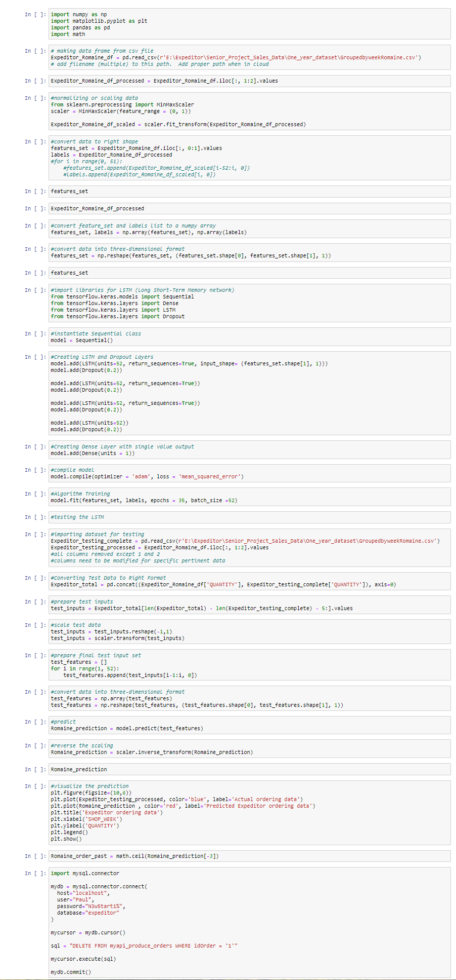
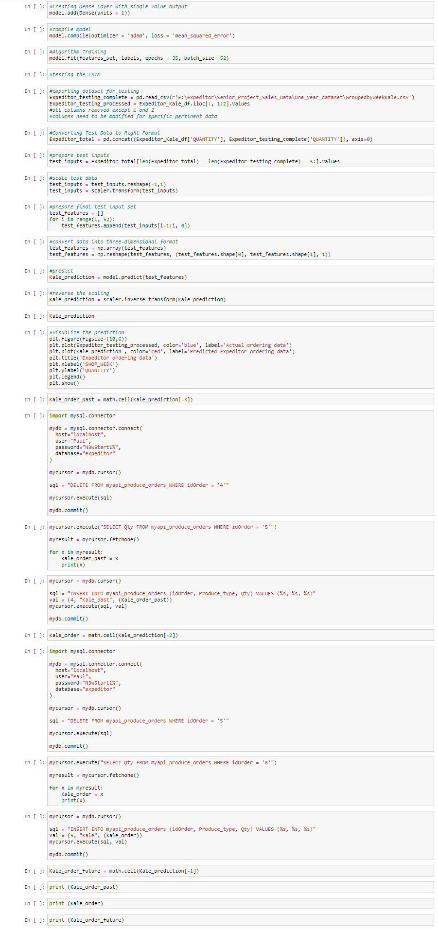
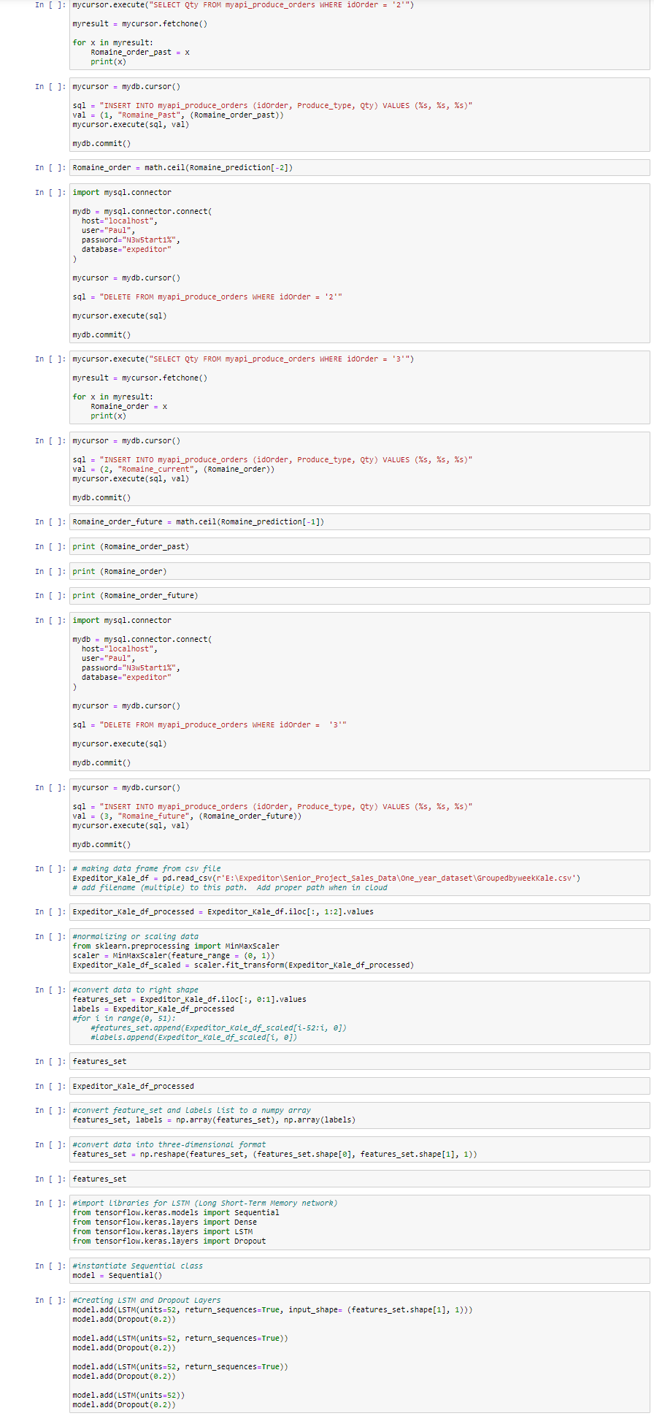
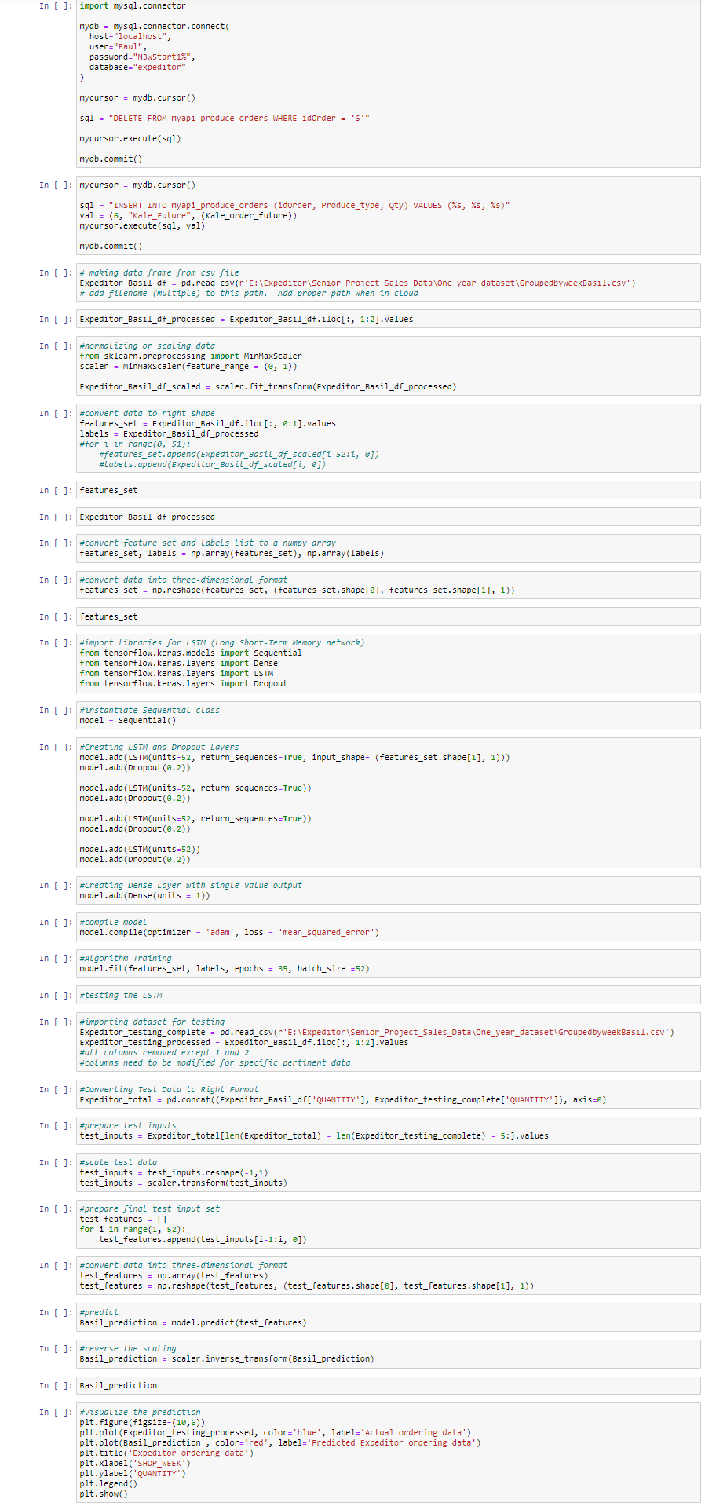
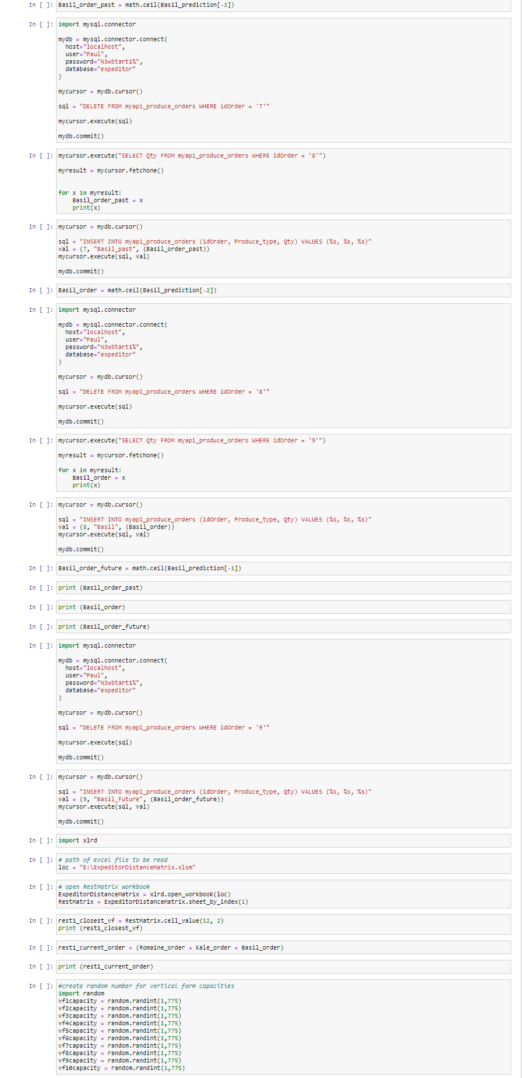
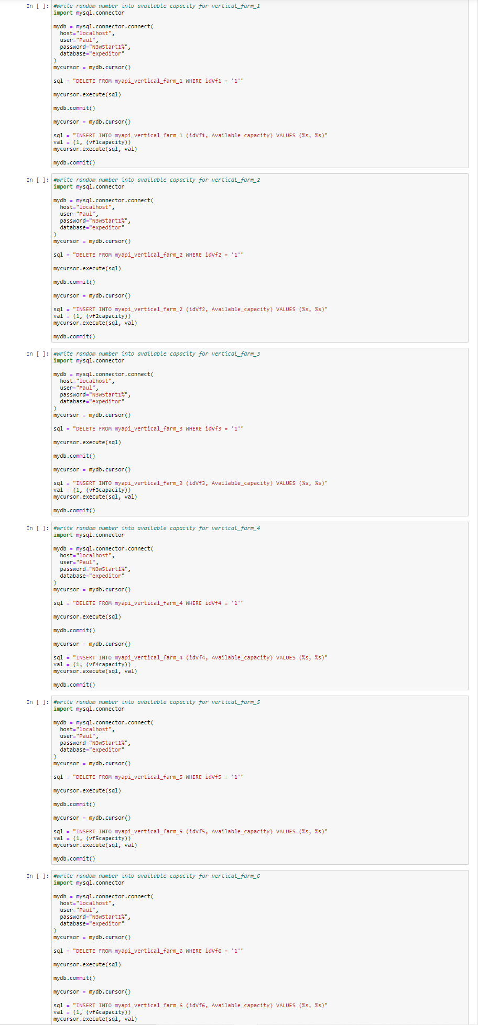
Step 1: The AI Expeditor Script
Written in Tensorflow environment in Python language with the Tensorflow and Keras libraries. Displayed in Jupyter Notebook. Uses a Long Short-Term Memory (LSTM) predictive recurrent neural network.
The script reads in an adapted 52-week sales data dunnhumby “Let’s Get Sort-of-Real” dummy supermarket sales dataset. https://www.dunnhumby.com/source-files/
For three products (Romaine, Kale, and Basil), the script interfaces with mysql, predicts a sales order quantity, writes it to the ‘future order’ rows, rewrites previous future order to ‘current order’ rows, and rewrites current order to ‘past order’ rows.

Slide 9
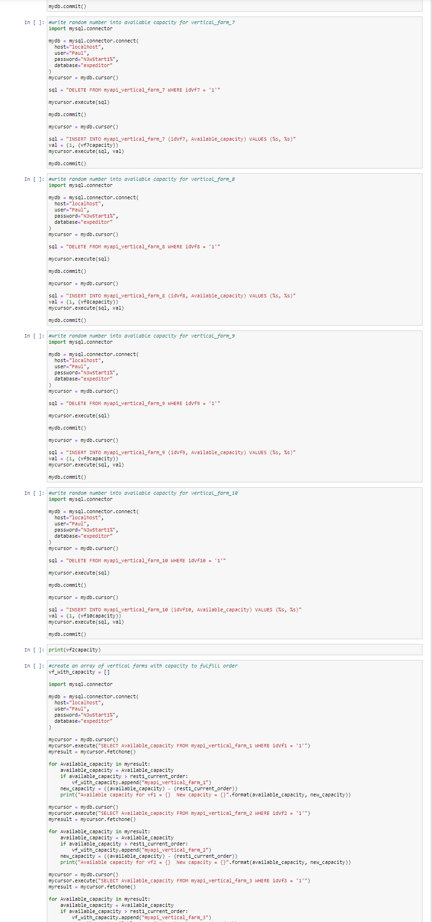
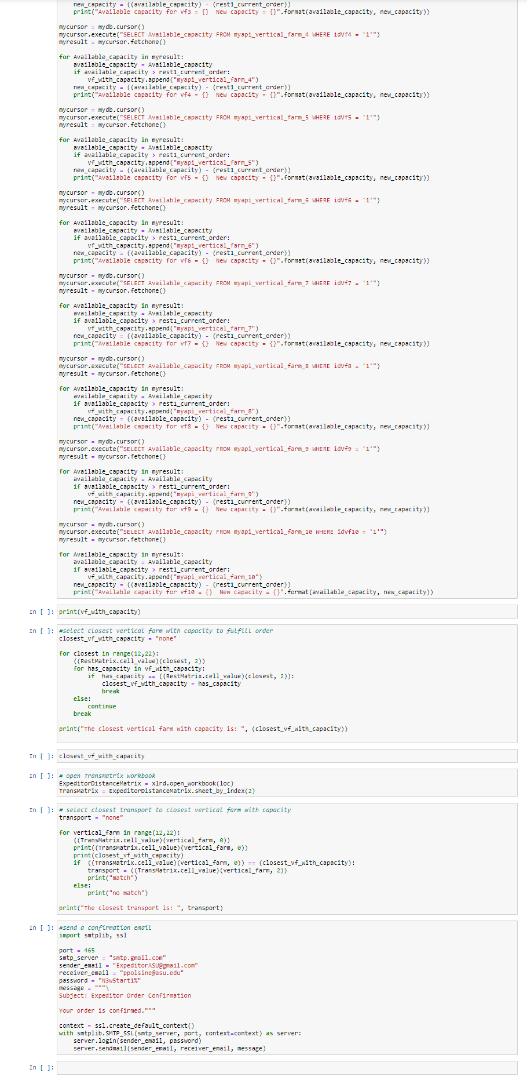
Step 1 continued: The AI Expeditor Script

Slide 10
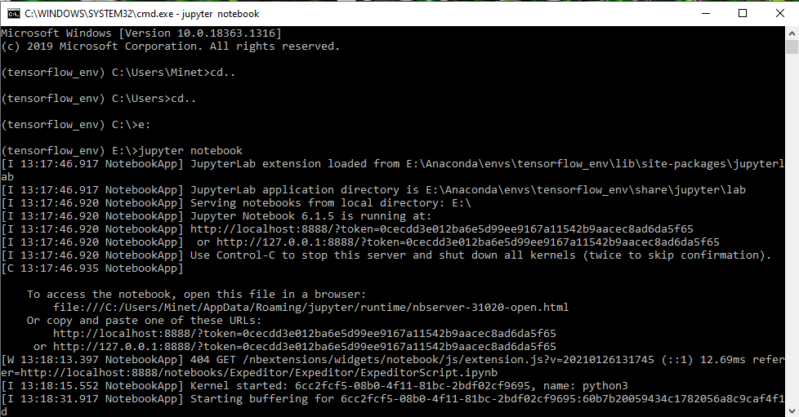
Tensorflow environment Jupyter Notebook cmd interface

Slide 11
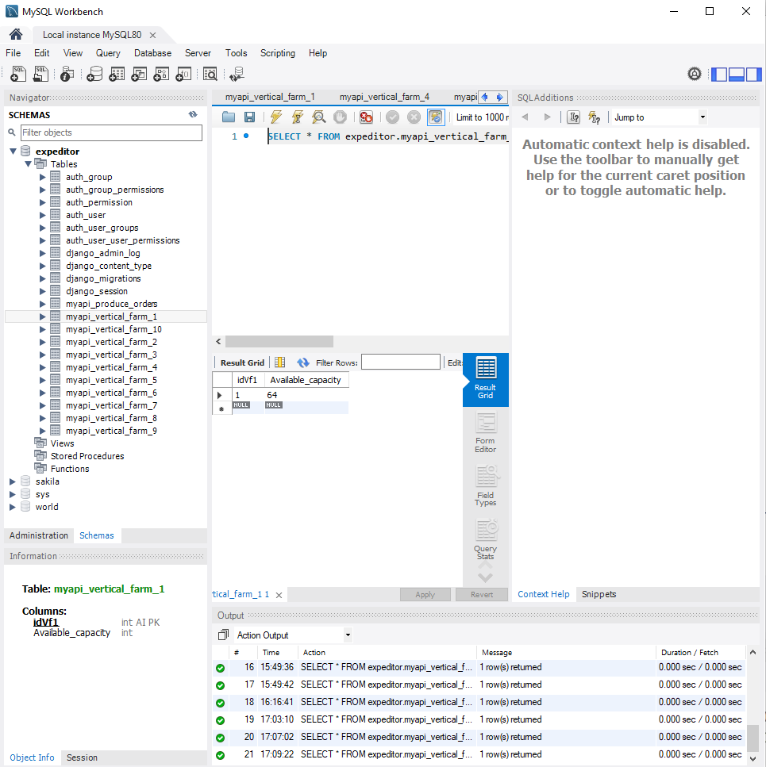
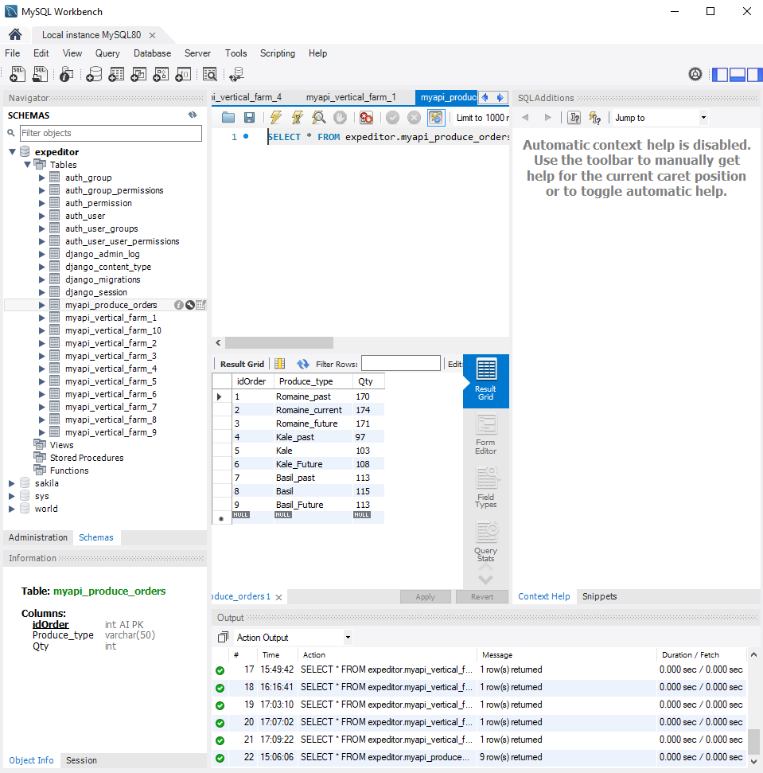
Step 2: The Expeditor Database
Interfaces with the Expeditor Script for predictive input and Django REST Framework for API transactions. Will contain more tables for Vertical Farm data and Transport data in coming builds.

Slide 12
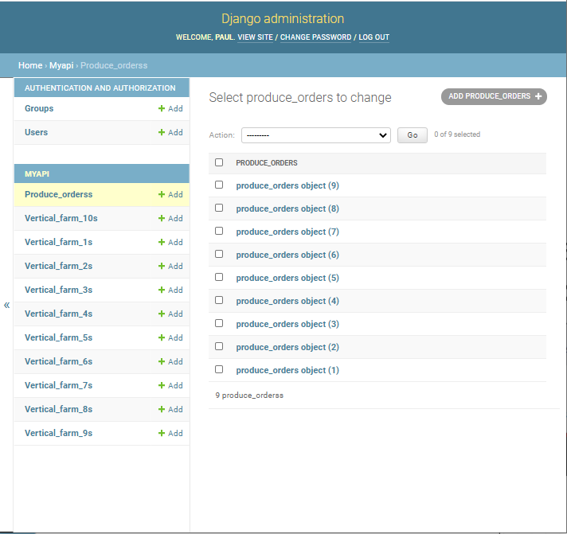
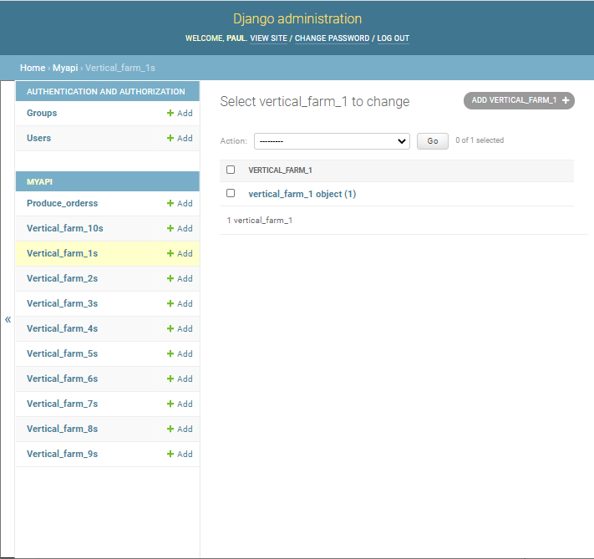
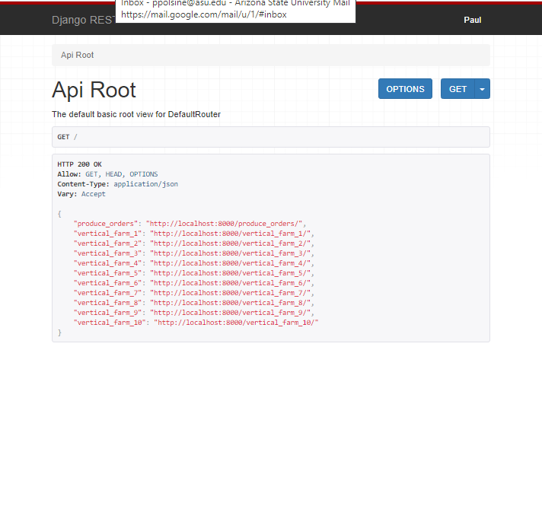
Step 3: Django Rest Framework
Interfaces with the Expeditor Database. It incorporates the Expeditor Supermarket and Restaurant User Interface within its framework and interacts with the HTML, CSS, and JS code through specialized coding interfaces.

Slide 13
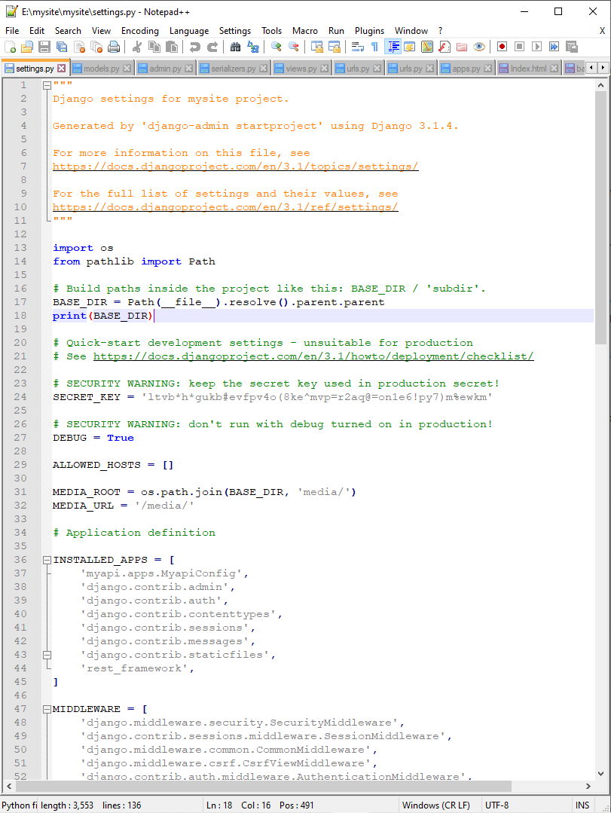
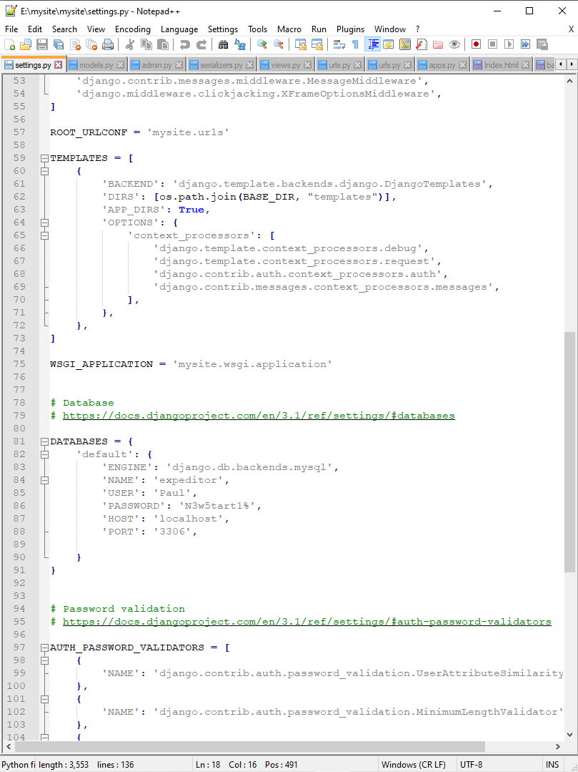
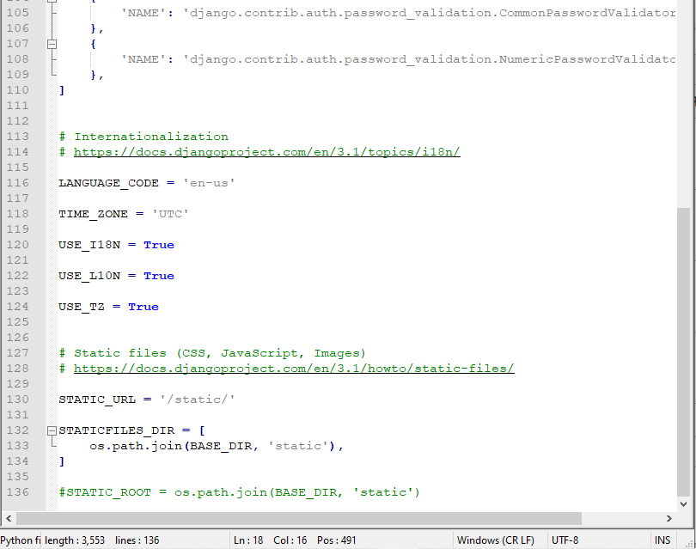
Step 3 continued: settings.py
Django settings.py file is the main file that creates the app that interfaces with the database, defines the database, connects to HTML templates, CSS, JS, and media files.

Slide 14
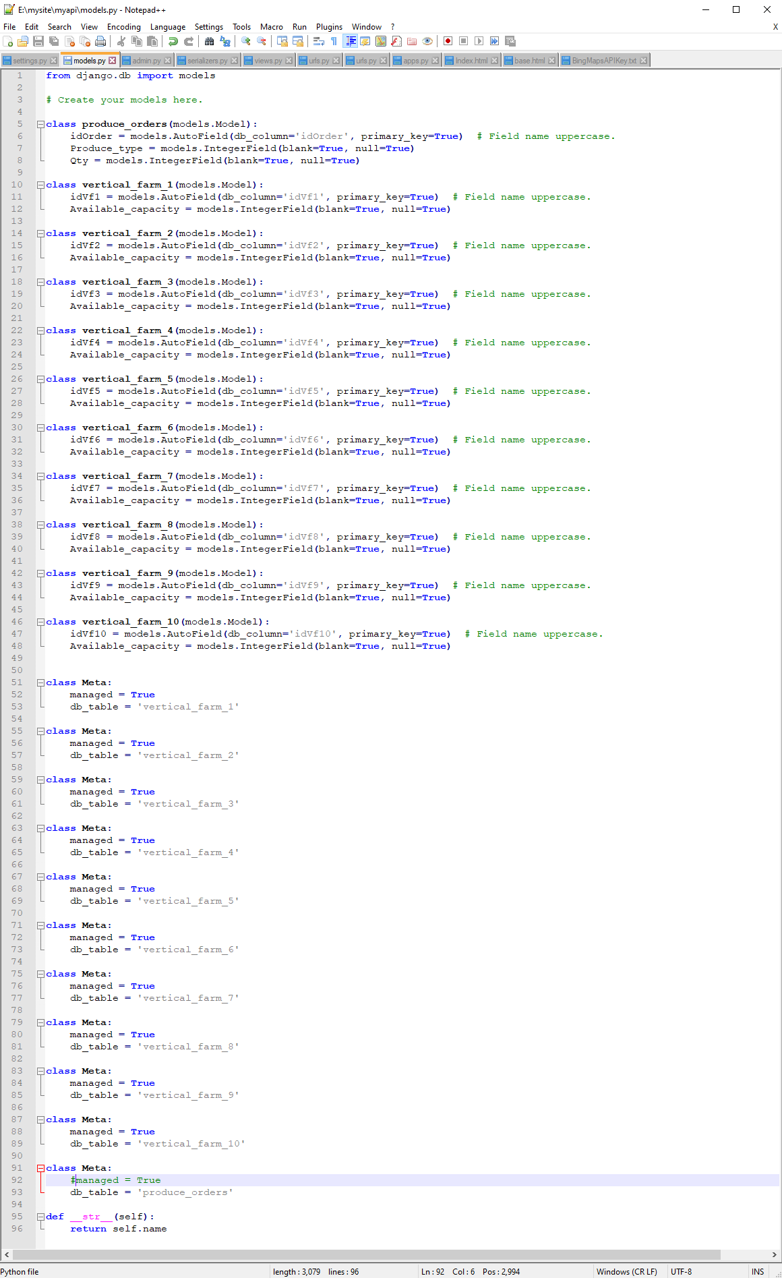
Step 3 continued: models.py
Django models.py file defines the db tables from the settings.py defined db within the Django REST Framework.

Slide 15
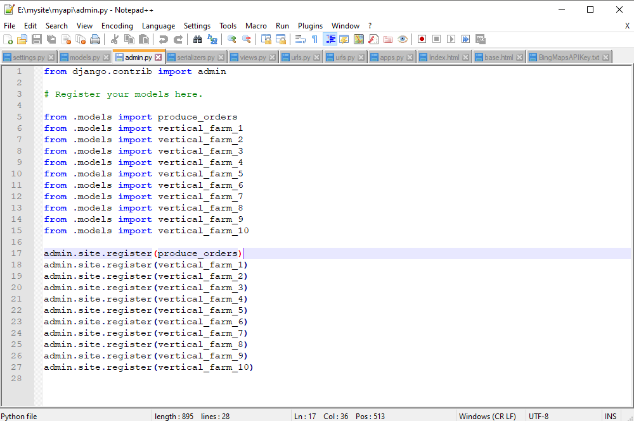
Step 3 continued: admin.py
Django admin.py registers the tables from models.py with Django administration so they may be acted upon within the framework.

Slide 16
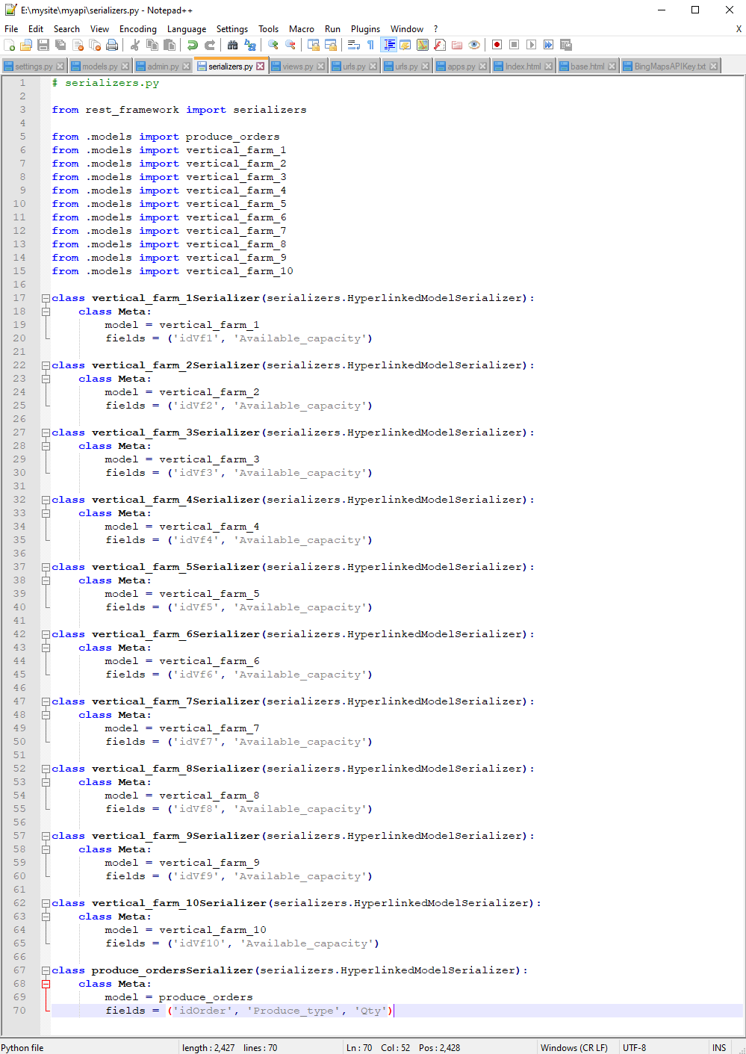
Step 3 continued: serializers.py
Django serializers.py connects and transforms the data in the tables into encapsulated json files.

Slide 17
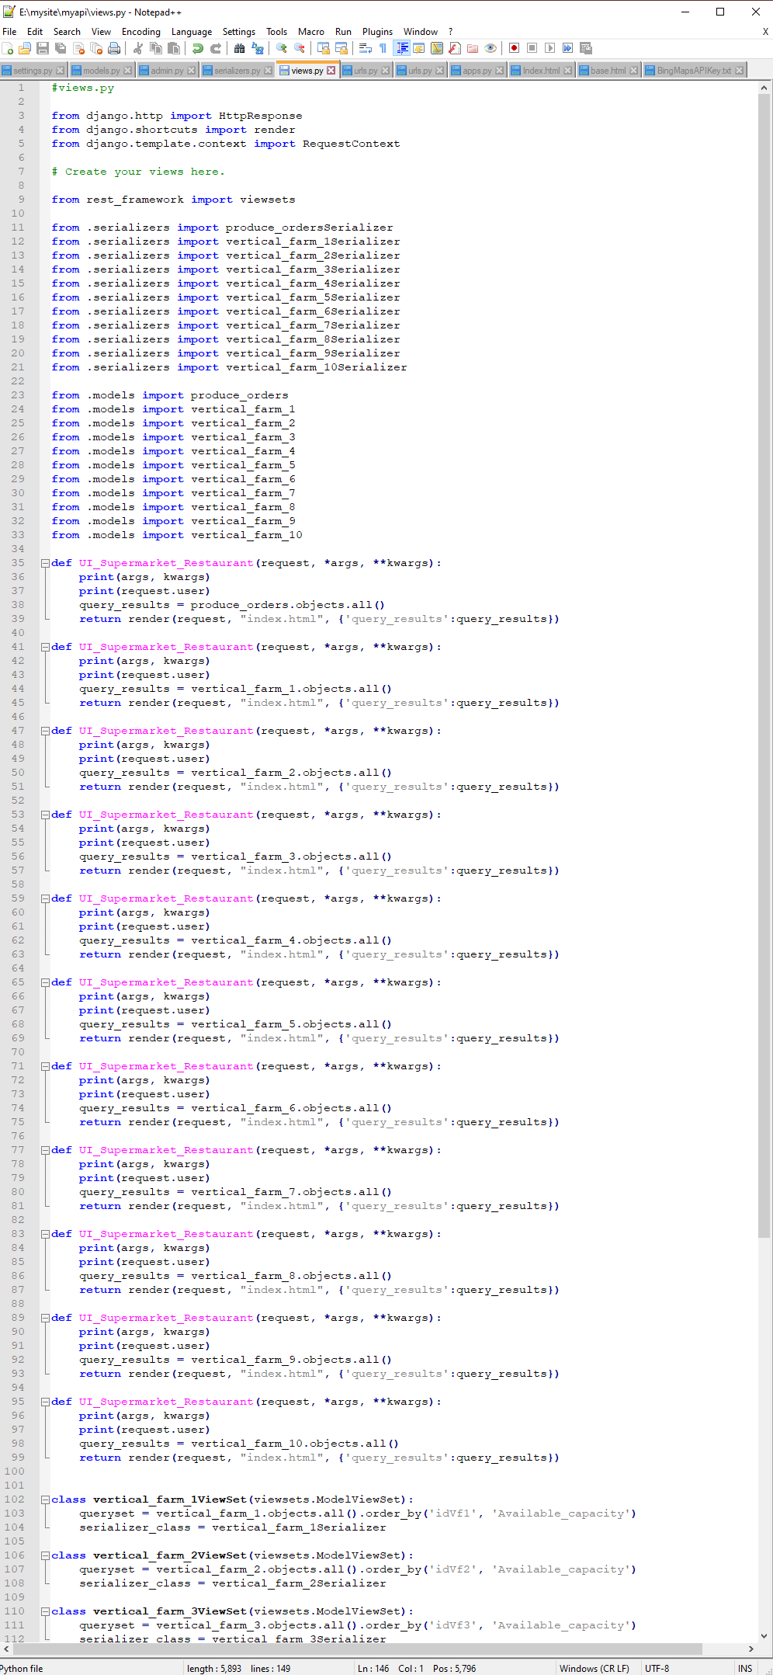
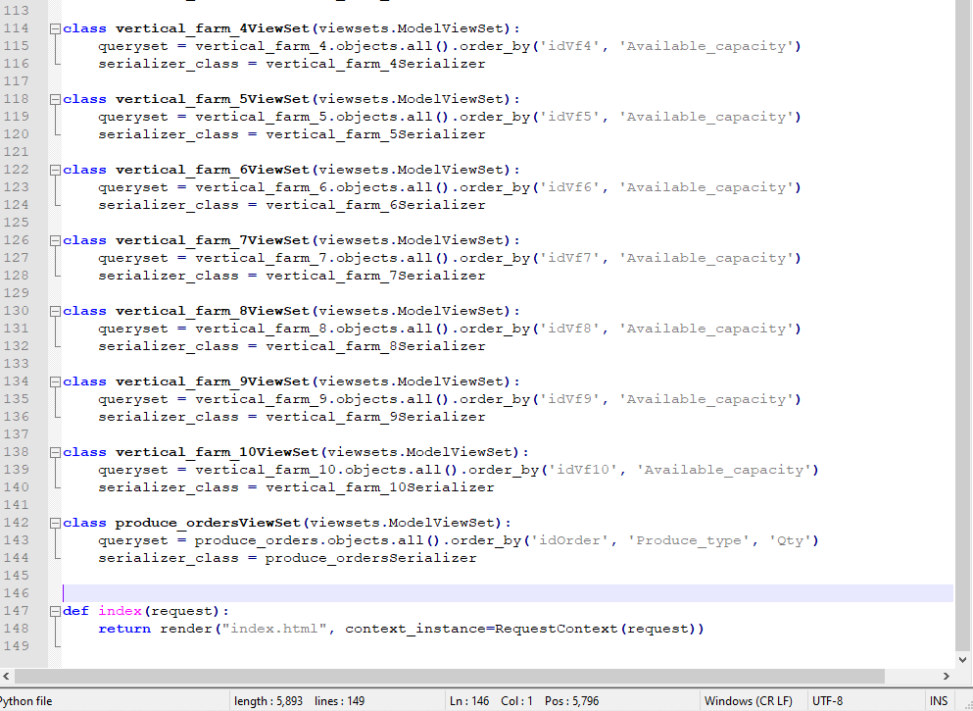
Step 3 continued: views.py
Djano views.py creates the functions that render the json data files into the UI tables.

Slide 18
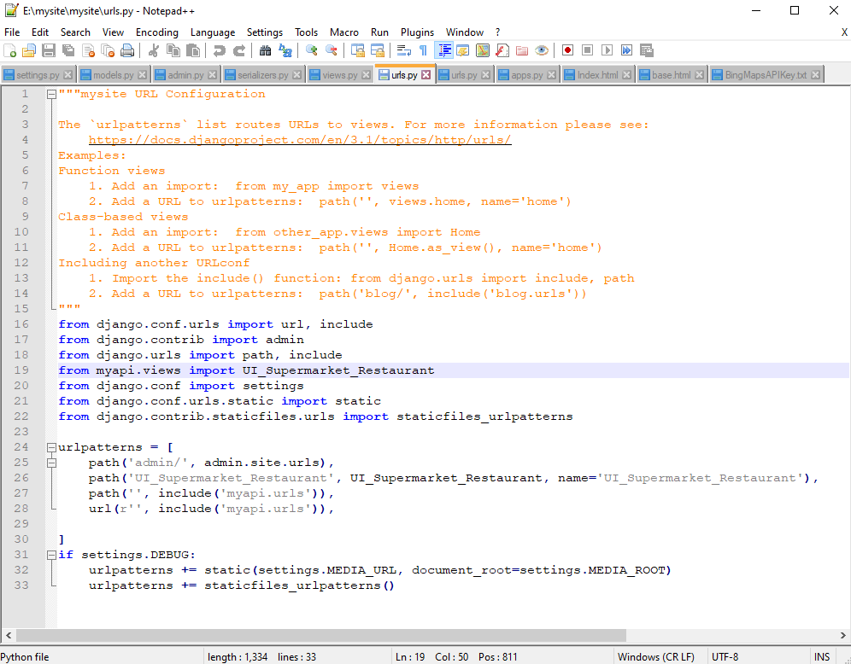
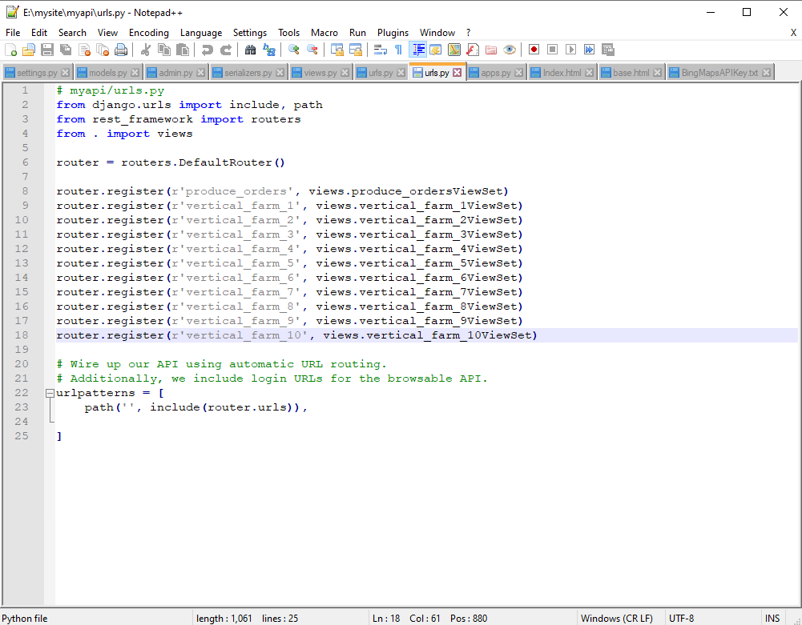
Step 3 continued: urls.py
There are two urls.py in Django REST framework that concern themselves with routing the data between the DB and the UI.

Slide 19
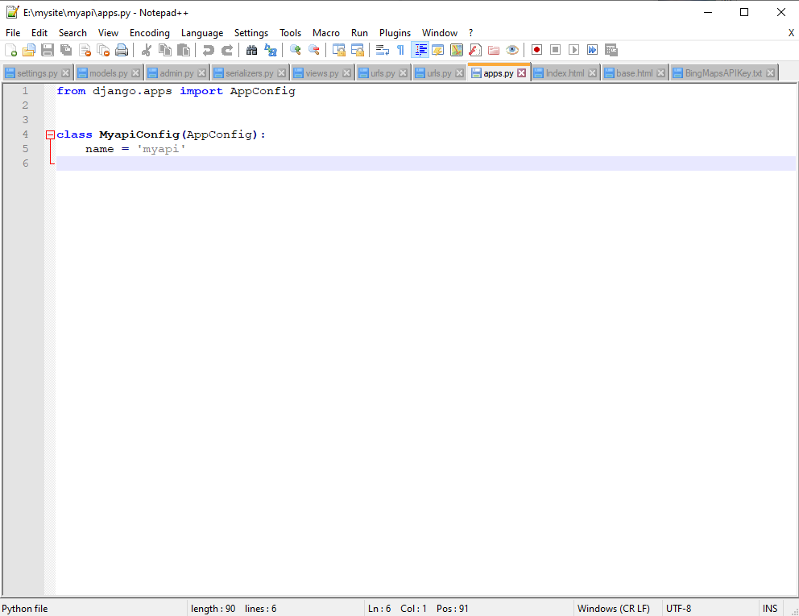
Step 3 continued: apps.py
Django apps.py holds the information about the apps created by settings.py.

Slide 20
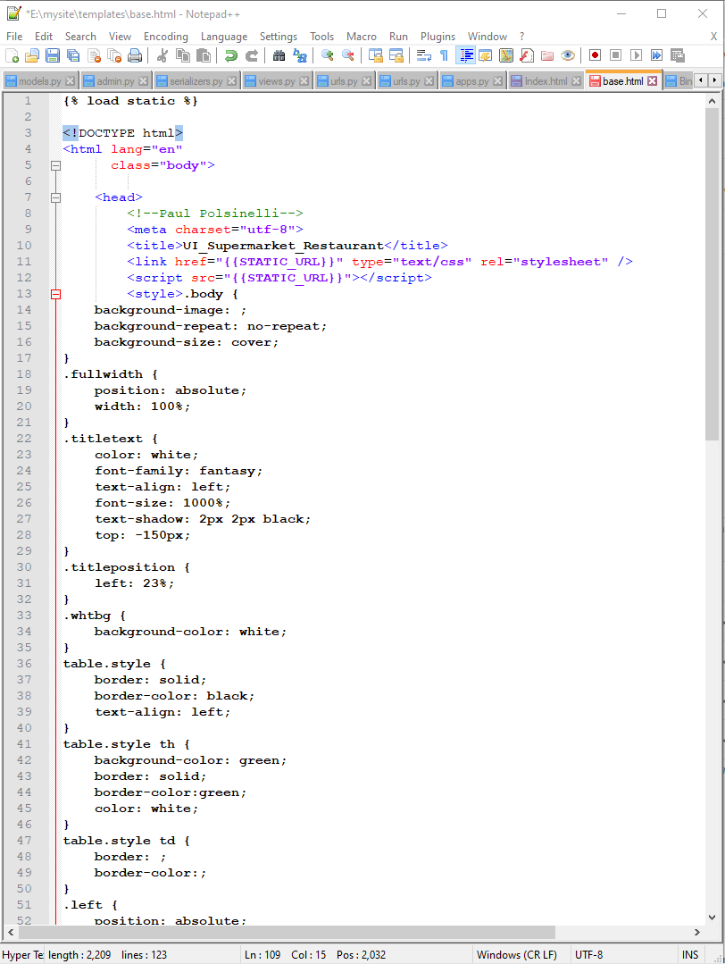
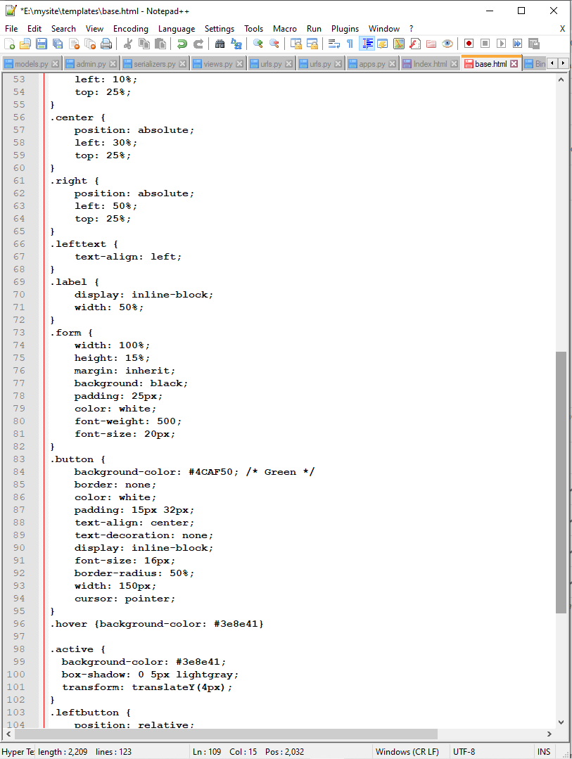
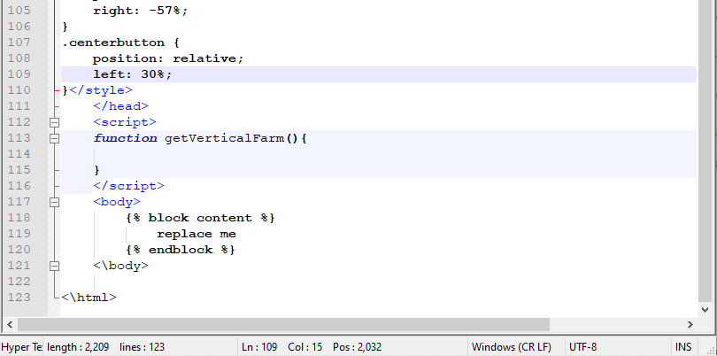
Step 3 continued: base.html
The main HTML file within the Django framework that holds the metadata and contains the connective code to the body and static files.

Slide 21
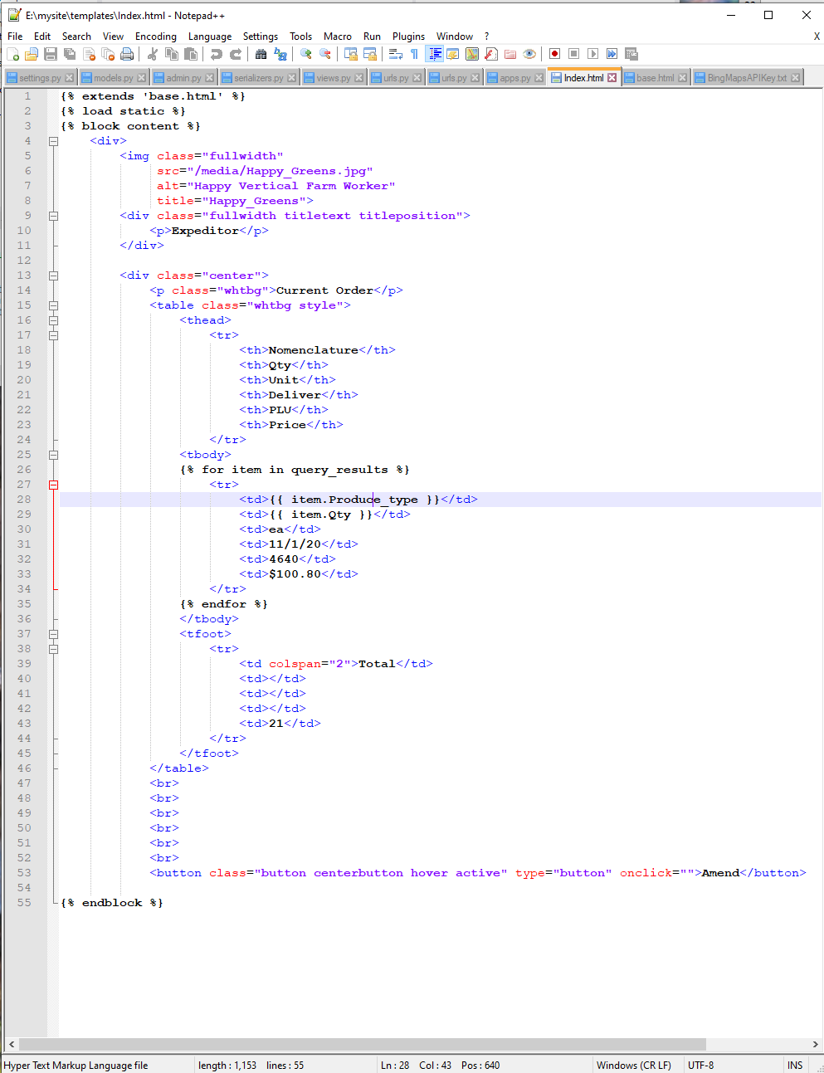
Step 3 continued: Index.html
The Django file that holds the body of the html code and connects to base.html.

Slide 22
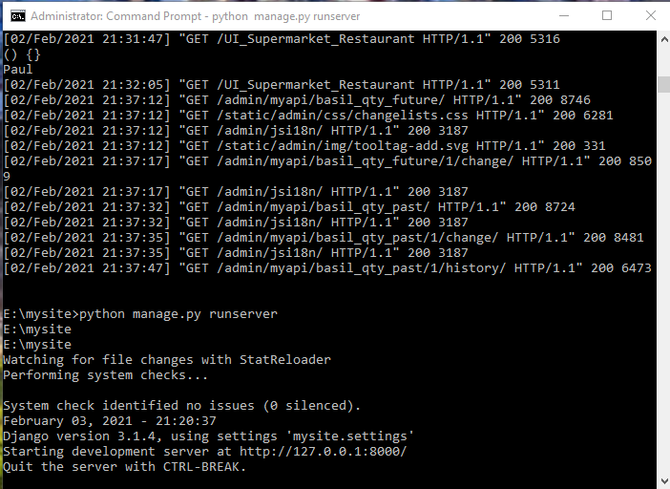
Django server cmd interface

Slide 23
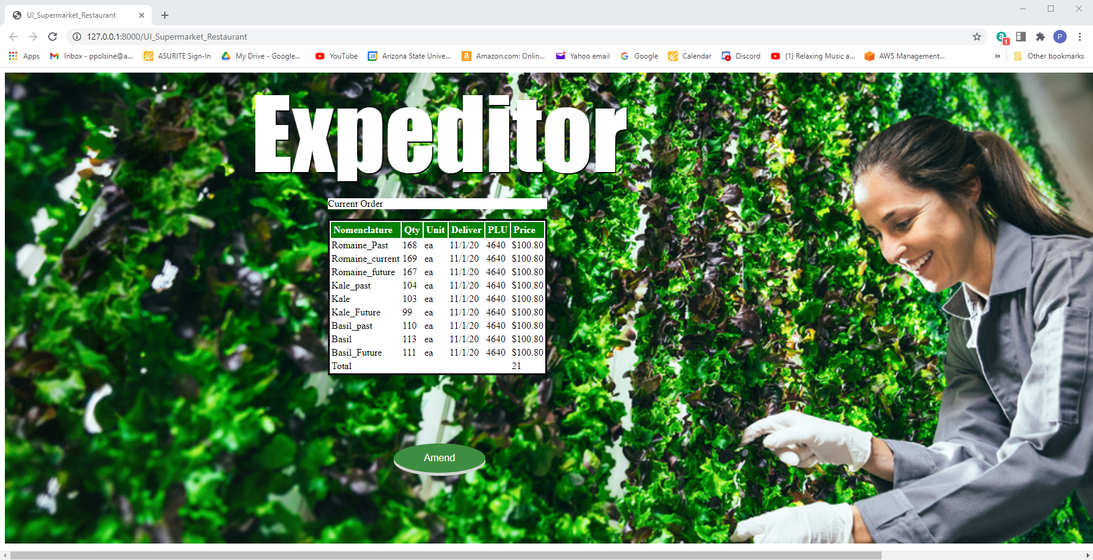
Step 4: Supermarket and Resturant UI

Slide 24
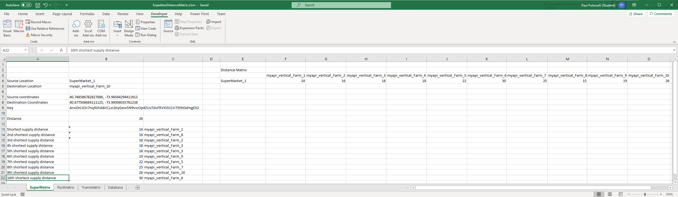
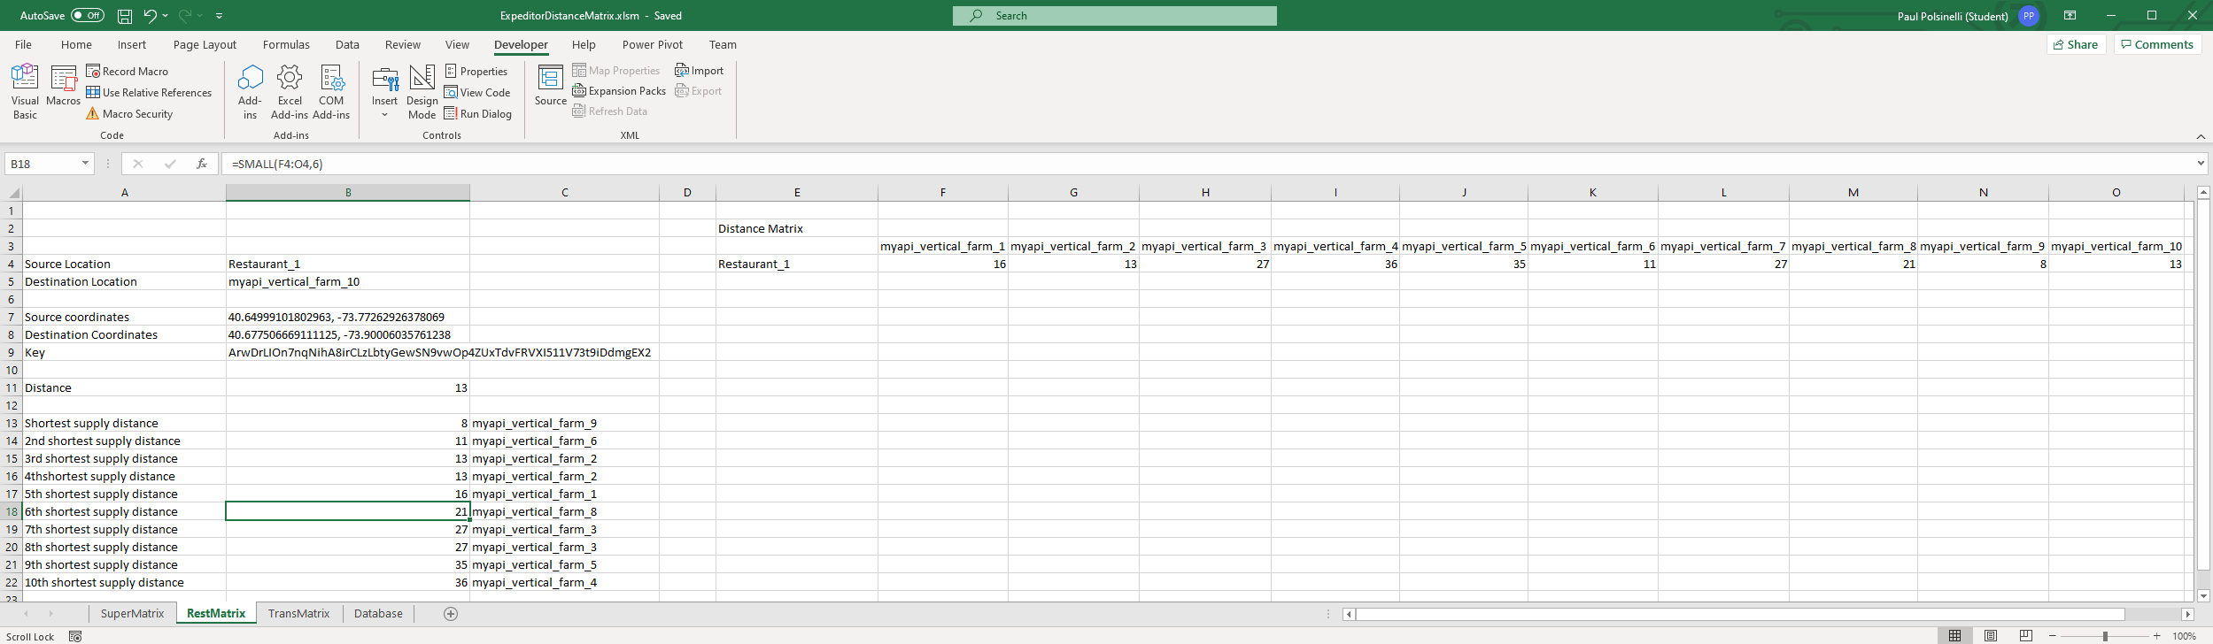
Step 5: Distance Matrix
Calculates the distances between the producers and suppliers

Slide 25
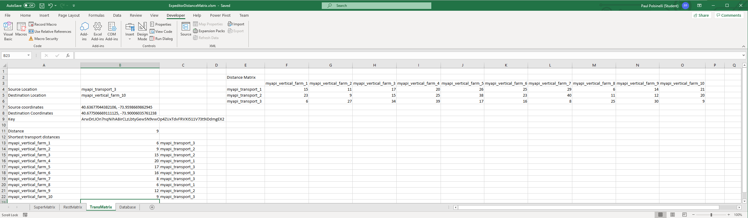
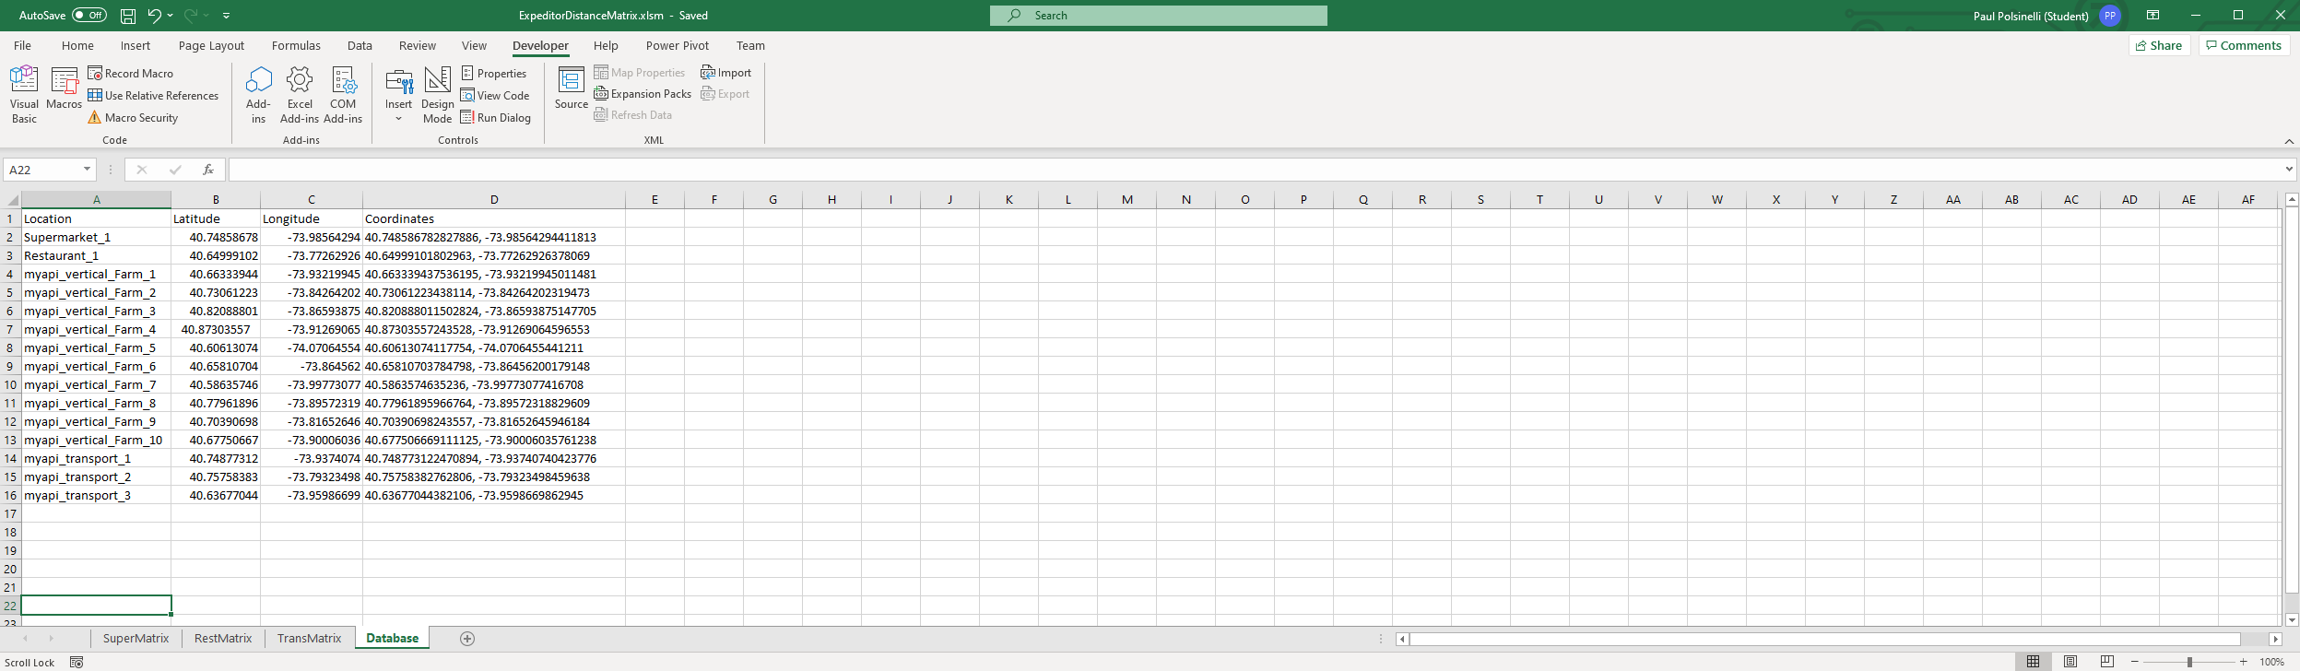
Step 5 continued: Distance Matrix

Slide 26
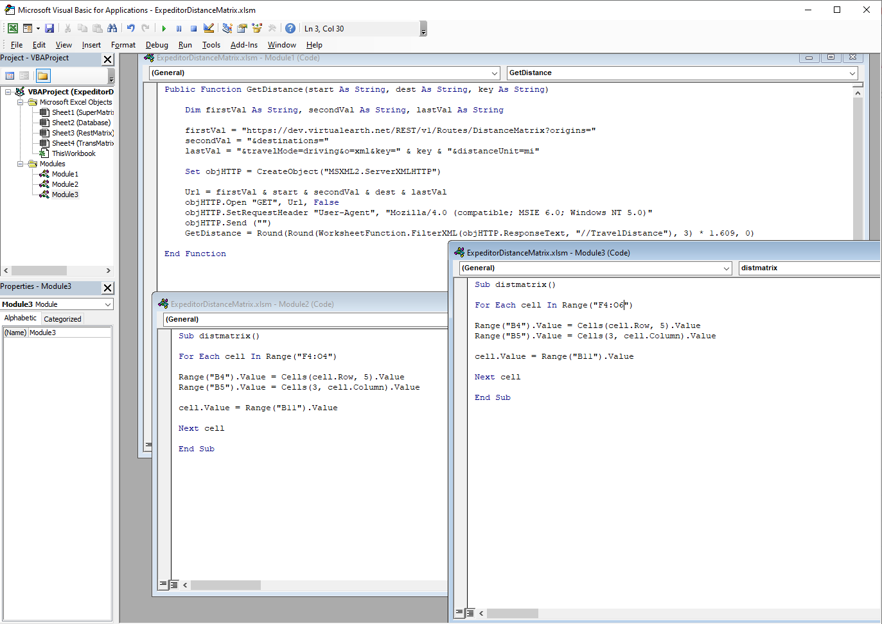
Visual Basic for Applications code for distance matrix
Code to utilize the Bing Maps API and to populate the distance matrices

Slide 27
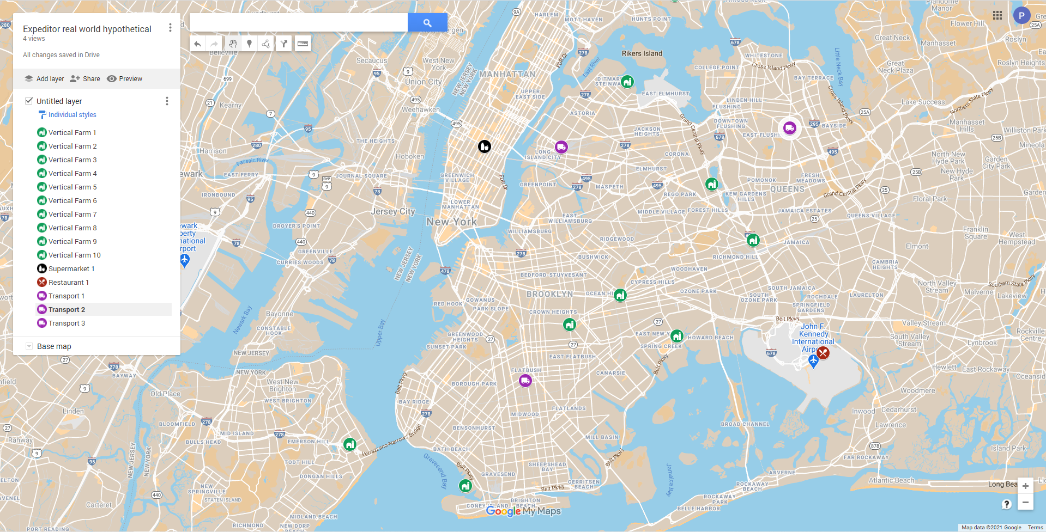
Real world map of Expeditor system

Slide 28
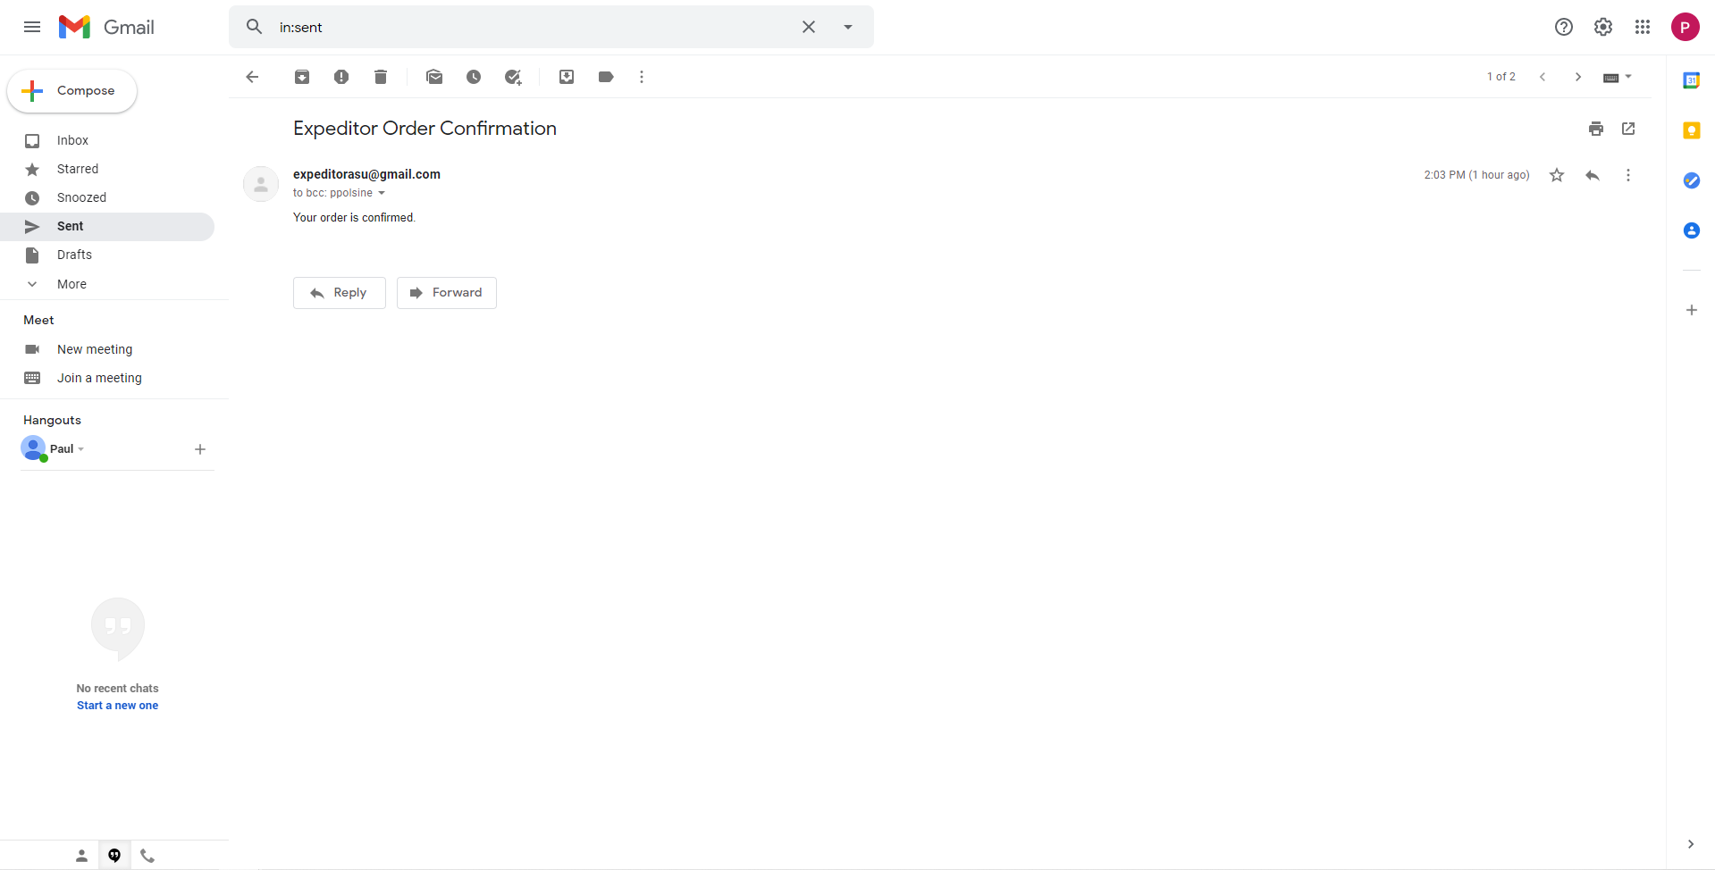
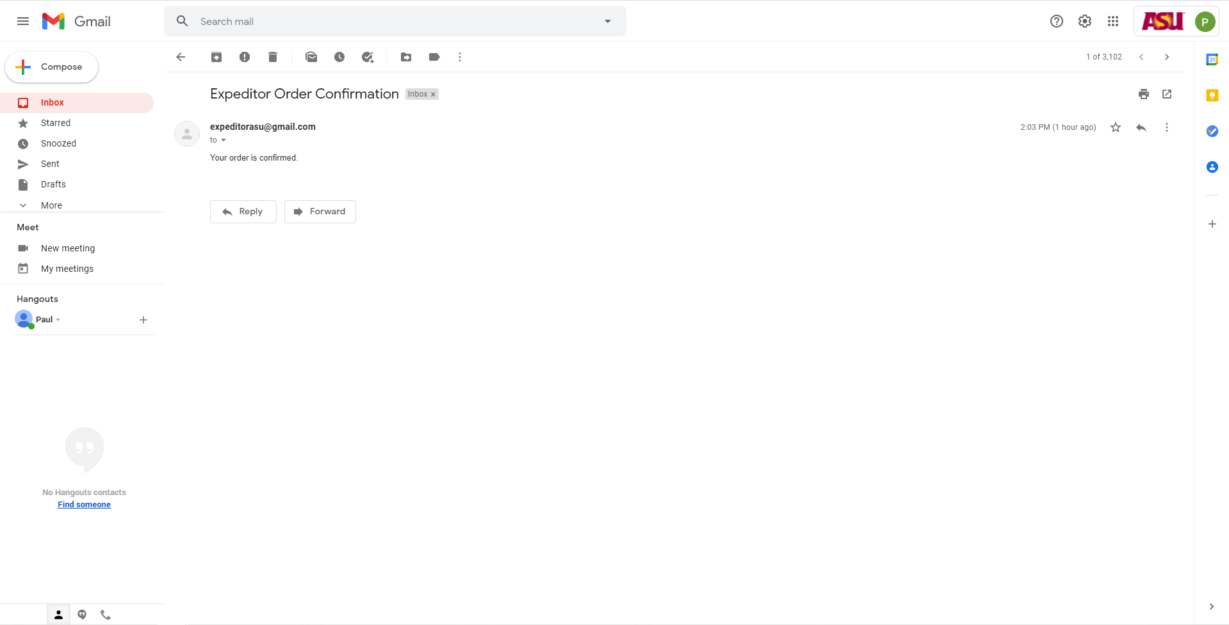
Step 6: email confirmation

Slide 29

Problems

Slide 30
Fixed Issues
Django again was a problem. While creating the new tables it did not want to migrate the new tables to the mysql db, not the first time I had this problem. I had to delete the produce orders table because it was trying to migrate it again and causing a duplication error as it was some sort of legacy dependent migration in the migrations folder. I still don’t understand why, but deleting the folder allowed me to perform the migration.
The coding was tedious this time. It took me a lot of troubleshooting to get my current changes working. I used a dynamic array and a nested loop to solve my biggest problem of selecting a vertical farm with the proper capacity for a given order.

Slide 31

Outstanding Issues
There are no current outstanding issues unresolved in this current build. There will be more functionality added and scaling in the next build, but everything built currently works without flaw.

Slide 32

What’s next?
The final build will see more tables added and scale increased again as more customers, suppliers, and transportation are added
The system will be fully automated with multiple orders and confirmation emails placed and sent with one iteration of the system
The UI’s design will be improved so that the table reads clearer, and an amend functionality will be added

